Slide 1
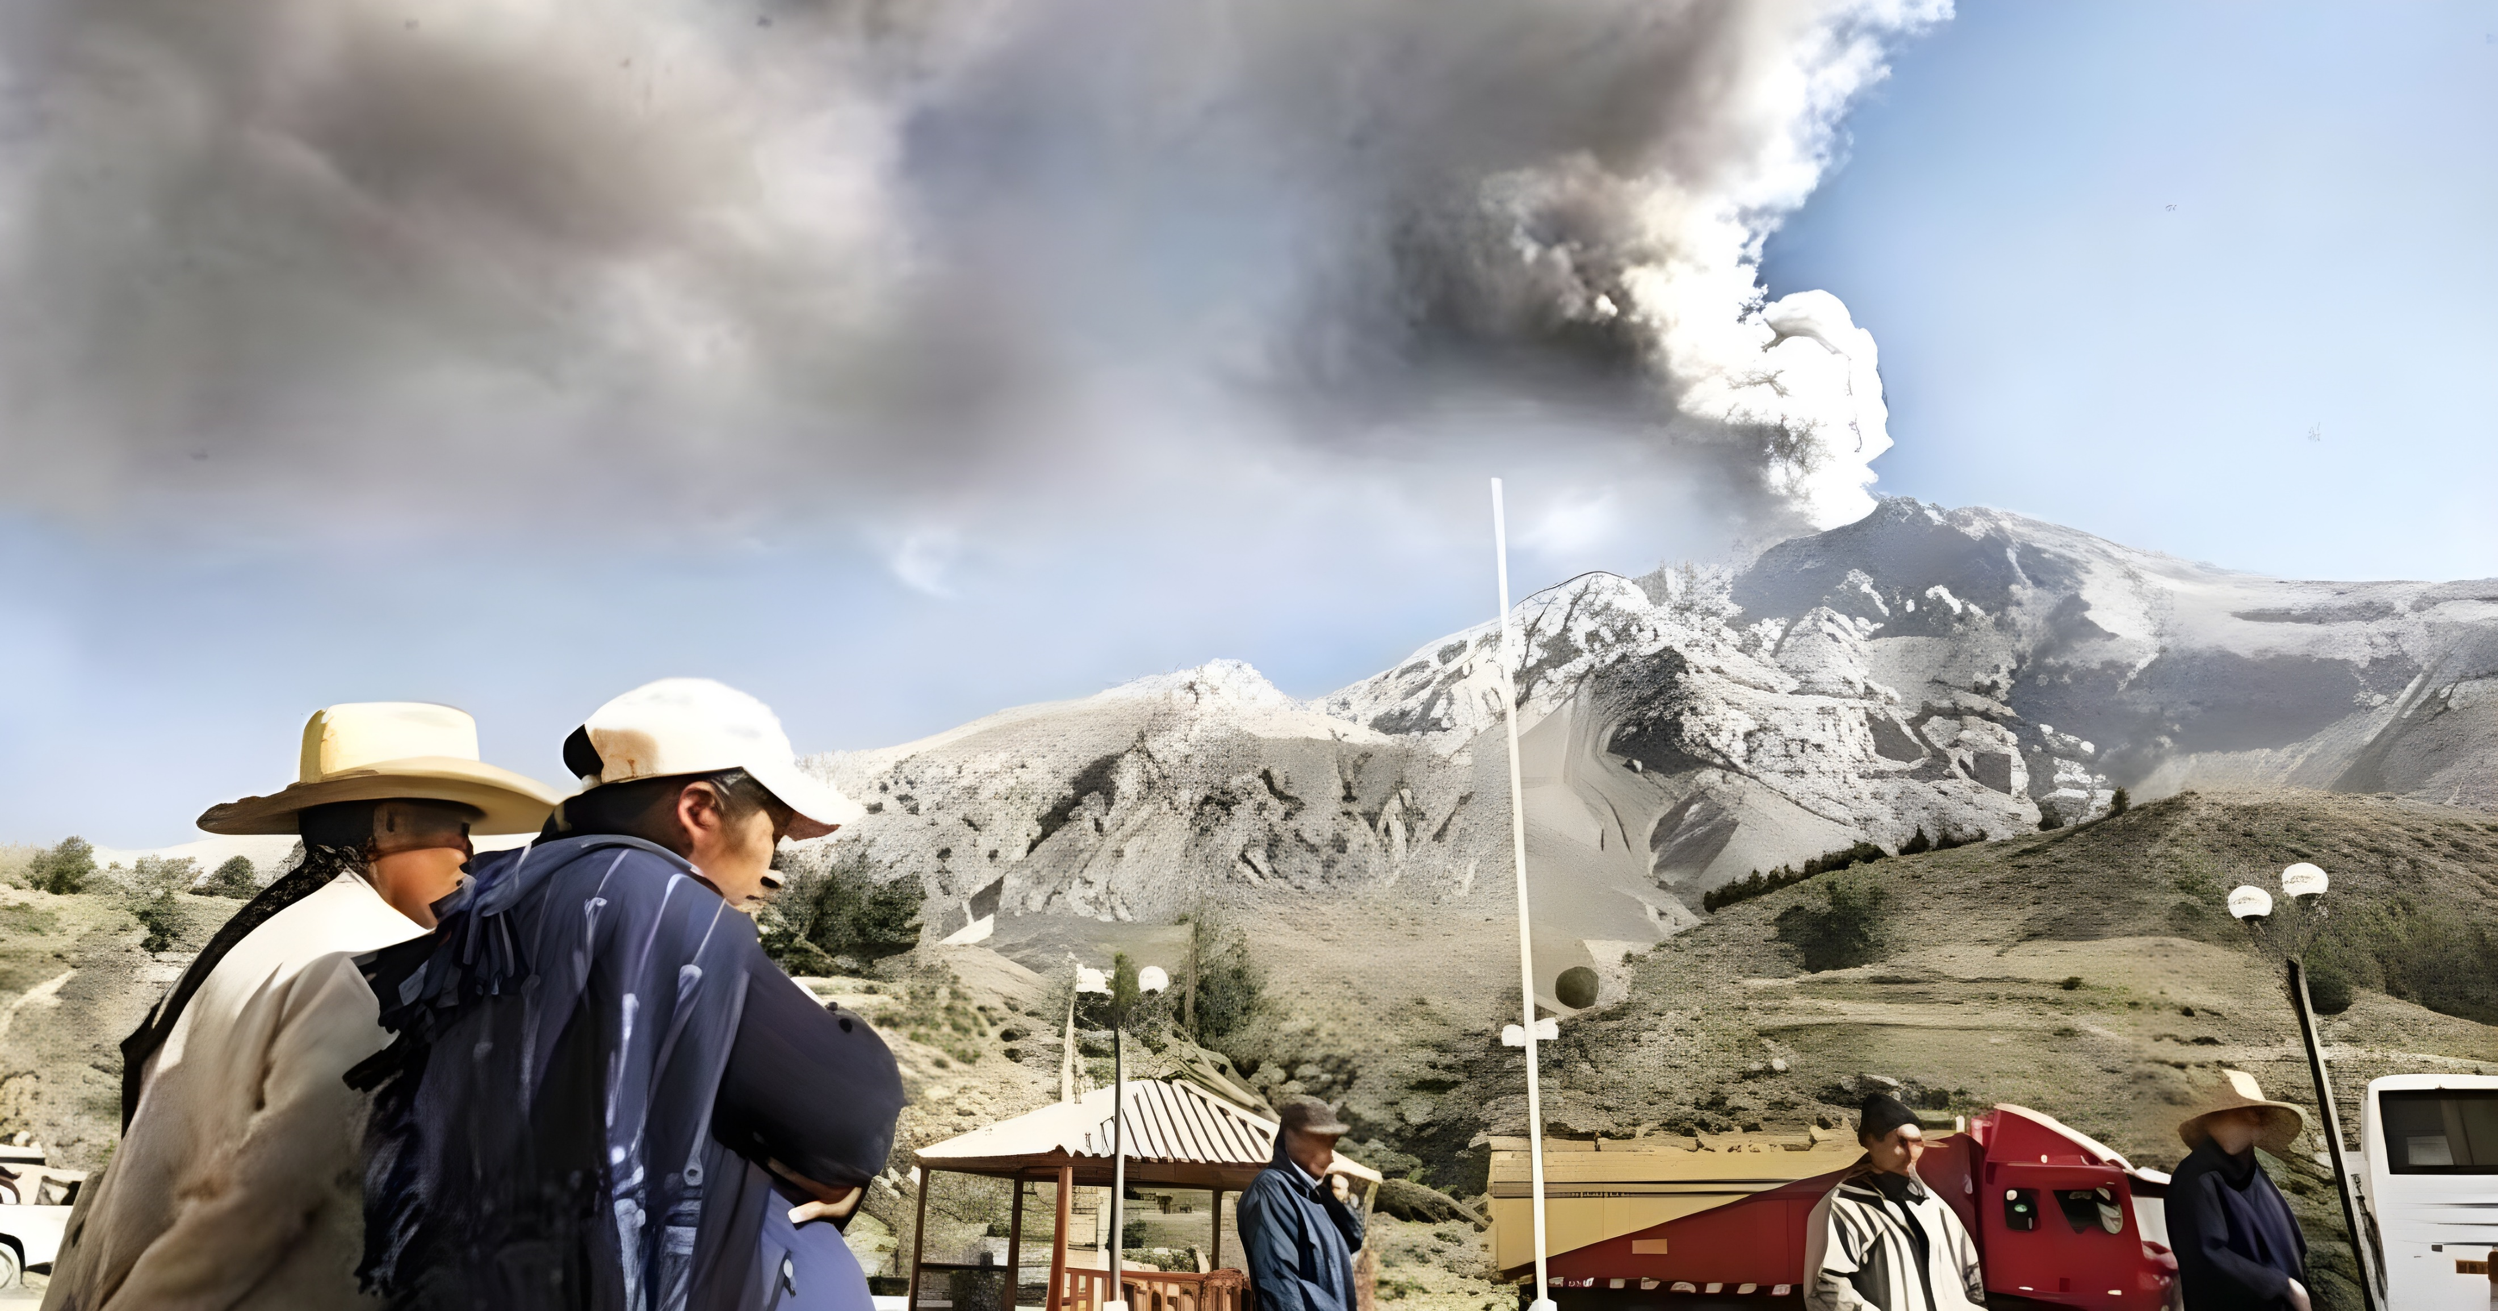
For the populations near Sabancaya or Ubinas, what would be an effective emergency plan for them?

Slide 2
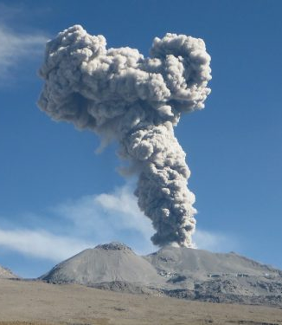
Important dates:
1986: Sabancaya volcano began eruptive process, and it was the beggining of research and active moritoring of Peruvian volcanoes.
2000: The cooperation between IGP and IRD from France allowed to train volcanology professionals.
2019: The geophysical network of volcanoes is 100% operational. Monitoring and warning of Ubinas eruption more than a week in advance.

